Slide 1
Day 3. Combining data sets

Slide 2
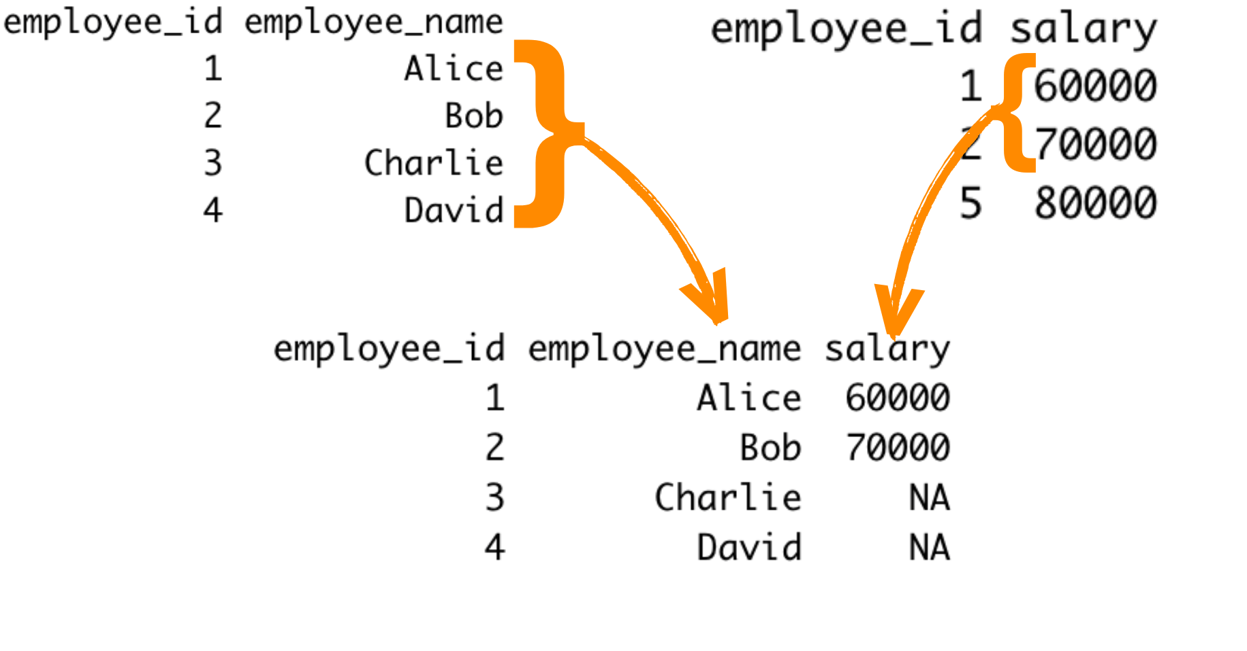
Data sets are objects in R

Slide 3
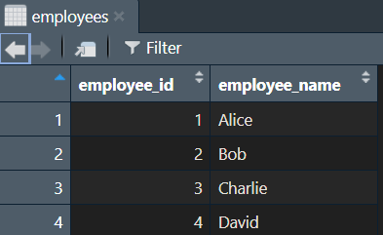
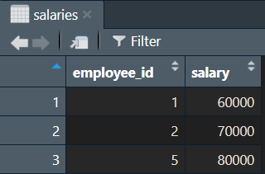
Merging the two objects
Let’s say you imported/created two R objects
employees<-
salaries<-

Slide 4
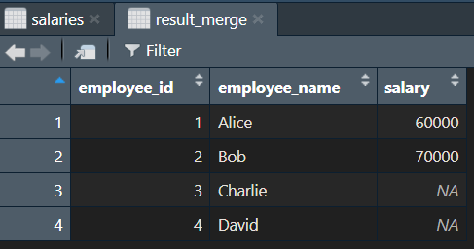
Merging with the function left_join()
library(dplyr)
result_dplyr <- left_join(employees, salaries, by = "employee_id")

